Slide 1
Summary papers
Maystadt 2014
Extreme weather and civil war: does drought Fuel conflict in Somalia through livestock price shocks?
Harari 2017
Confict, Climate and Cells: A disaggregated analysis
Weezel 2019
Local warming and violent armed conflict in Africa
Linke et al. 2021
Weather, wheat, and war: Security implications of climate variability for conflict in Syria

Slide 2
Maystadt 2014
Extreme weather and civil war: does drought Fuel conflict in Somalia through livestock price shocks?
Establish whether that the causal relationship between weather extremes and conflict holds at the local level and for a relatively short time frame (a decade) in the case of Somalia
Analyze variation in conflict incidence at the subnational level and between neighbouring countries.
Explore the key mechanisms that link climate and conflict.
Examine livestock price shocks to shed light on the impact that local producer prices have as incentive factors of conflict participation

Slide 3
Variables and data
The conflict variable is constructed as the sum of violent conflict events in each administrative unit per month, using the Armed Conflict Location and Event Dataset (ACLED 2011).
The weather variables - temperature and precipitation anomaly and drought length - are constructed from climatic data provided by the University of East Anglia Climatic Research United (UEA-CRU 2011). The UEA-CRU time-series datasets, version 3.1, report average temperatures and total precipitation by months at data points of a high-resolution grid (of 0.5 × 0.5 degree or approximately 56km × 56km at the equator), which are based on measurements from weather stations distributed around the world.
Monthly market price data for livestock and key commodities are available by region (and district) from the Food Security and Nutrition Analysis Unit database (FSNAU 2011b). https://fsnau.org/

Slide 4
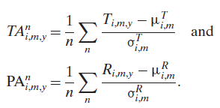
Variables
time-specific temperature anomalies
time-specific precipitation anomalies
Two dimensions of drought:
the drought intensity measured over a constant time interval, and determined by temperature anomaly.
the length of the drought period

Slide 5
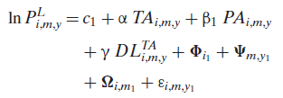
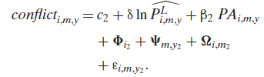
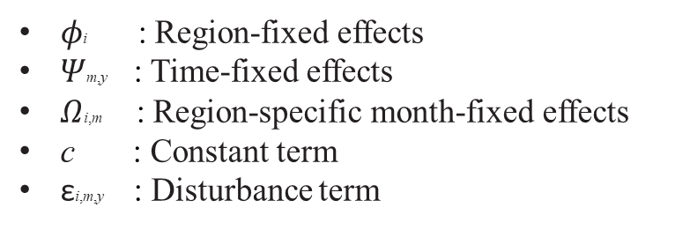
Model
The first-stage equation, which estimates the effects of abnormal temperatures and drought length on livestock prices, is:
TAi,m,y : temperature anomalies
PAi,m,y : precipitation anomalies
DL^{TA} i,m,y : drought length
region- and time- specific price index of livestock L
The second-stage equation, which yields the effects of livestock prices on the number of conflict events, is :
$φ$i : Region-fixed effects
$Ψ$m,y : Time-fixed effects
$Ω$i,m : Region-specific month-fixed effects
c : Constant term
εi,m,y : Disturbance term

Slide 6
Harari 2017
Confict, Climate and Cells:
A disaggregated analysis
We conduct a disaggregated empirical analysis of civil conflict at the subnational level in Africa (46 countries) over 1997-2011 using a new gridded dataset.
We construct an original measure of agriculture-relevant weather shocks exploiting within-year variation in weather and in crop growing season, and spatial variation in crop cover.
Negative shocks occurring during the growing season of local crops affect conflict incidence persistently, and local conflict spills over to neighboring cells.
Using maximum likelihood we estimate the probability that a cell experiences at least one conflict event during the year as a function of contemporaneous and lagged SPEI and spatial and temporal lags of conflict.

Slide 7
Variables and model
ANY EVENT is a binary indicator for whether the cell has experienced a conflict-related episode in a given year.
C is a generic climate indicator (e.g. precipitation) and GS₋C is the climate indicator measured in the cell-specific growing season. Our main climate indicator is the Standardized Precipitation-Evapotranspiration Index (SPEI).
X is a vector of time-invariant controls (e.g., terrain characteristics) and γ and µ denote year and country fixed effects, respectively.
Model I

Slide 8
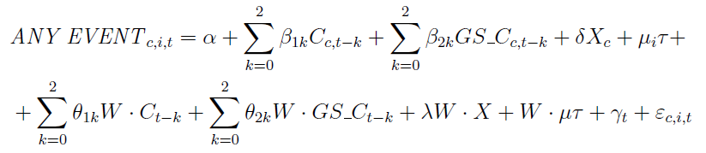
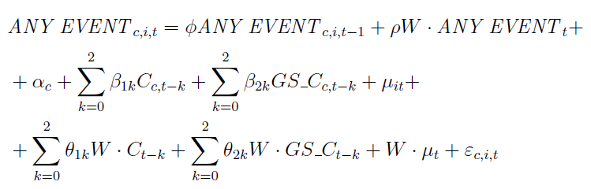
Model
Model II
Includes a spatial lag of the exogenous regressors, to control for spatial correlation in the covariates.
W is a binary contiguity matrix :
1 is assigned to cells surrounding the cell of interest
0 to other cells
Model III
Includes lags of the endogenous variable in time and space

Slide 9
Data
Data on conflict come from the PRIO/ Uppsala ACLED dataset
Our main climate indicator is the Standardized Precipitation-Evapotranspiration Index (SPEI).
While most of the conflict literature has focused on precipitation, the impact of rainfall on the growing cycle of a plant depends also on the ability of the soil to retain water. This is captured by “potential evapotranspiration“ which in turn depends on temperature, latitude, sunshine exposure, and wind speed. SPEI reflects this and has been found to generally outperform other indexes in predicting crop yields.
The climate inputs we employ to compute SPEI are drawn from a high-quality re-analysis dataset (ECMWF ERA-Interim), which relies on weather stations, satellites, and sondes.

Slide 10
Weezel 2019
Local warming and violent armed
conflict in Africa
Focusing on the African continent, shifts in average temperature and precipitation levels are used to estimate the effect on conflict risk between 2003–17.
The data is analysed using Bayesian model averaging to test if the variables measuring local climatic conditions contribute consistently in explaining conflict risk.
Temperature is robustly linked to armed conflict, while precipitation changes have no discernible effect.

Slide 11

Model and variables
Focuses on relatively long-term changes in local climate, rather than relying on within-year variation
C_{i} measures conflict in region i (e.g. a country or grid-cell). The outcome variable is often coded using a binary indicator for conflict incidence. It is linked to the temporal lag LC_{i}, to account for state-dependence
X’_{i} is a vector of control variables (e.g. population or income levels);
ΔW_{i} captures change in local climatic conditions measured by the difference in average anomalies for temperature and precipitation. An anomaly is measured as the deviation from the long-term (typically 30 years) mean.
α is a constant and ε_{it} the error term

Slide 12
Variables and data
Temperature data is taken from the Berkeley Earth Surface Temperature (BEST) dataset. An important advantage of BEST of other comparable datasets is that it is not as vulnerable to conflict-related station loss.
The monthly data is aggregated to calculate annual average temperature. These annual averages are used to construct the variable that serves as a proxy for climate change. Specifically, the variable of interest is the change in the average temperature anomaly for 2003–17 relative to the benchmark period (1988–2002).
Precipitation data is taken from the CHIRPS (Climate Hazards Group InfraRed Precipitation with Station) dataset
Conflict data is taken from the Georeferenced Event Dataset (GED, version 18.1) from the Uppsala Conflict Data Programme. First, an event is included only when it is associated with a conflict that has reached a fixed fatality threshold of at least 25 battle-related deaths

Slide 13
Linke et al. 2021
Weather, wheat, and war: Security implications
of climate variability for conflict in Syria
Examine how Syria’s local growing seasons and precipitation variability affected patterns of violence during the country’s civil war (2011–19).
Test the hypotheses :
Government-initiated (H1) and rebel-initiated (H2) conflict events will be more likely during the growing season than at other times of the year.
During the growing season, precipitation deficits will be associated with more government initiated (H3) and rebel-initiated (H4) violence.

Slide 14

Model
H1-H2
For our growing season models, we use ordinary least squares (OLS) regression to estimate whether a subdistrict experienced conflict Y in unit i and month t as a function of:
Y_{itw} : spatial autoregressive term measuring the average number of conflict events by the actor in a first-order subdistrict neighboring weights matrix w
X_{it} : growing season effect
Y_{it-1} : previous subdistrict conflict
i_t : grid-month fixed effects
o : year fixed effects
C : temperature

Slide 15

Model
H3-H4
We use an OLS model to test precipitation deficit effects. We consider rainfall to be a randomly assigned treatment variable. These estimates are slightly different than for the growing season models:
X_{it} : SPI effect
o_p : month-province fixed effects
i : subdistrict fixed effects

Slide 16
Data
Climate Hazards group Infrared Precipitation with Stations (CHIRPS) rainfall dataset. We identify the main wheat growing season using phenology data from the Anomaly Hotspots of Agricultura Production (ASAP) research initiative.
We control for temperature using the ERA5 daily average 2m surface air temperature data at a 0.25(*25km) spatial resolution from the EMCF Copernicus project.
For the duration of the war (2011–18), we use the Integrated Crisis Early Warning System (ICEWS) data (ICEWS, 2016). ICEWS is a collections of events based entirely on automated coding without intervening researchers.
It contains georeferenced conflict incident database that records interactions between social and political actors.

Slide 17
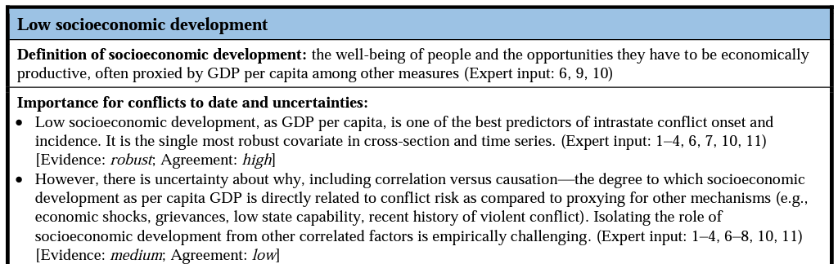
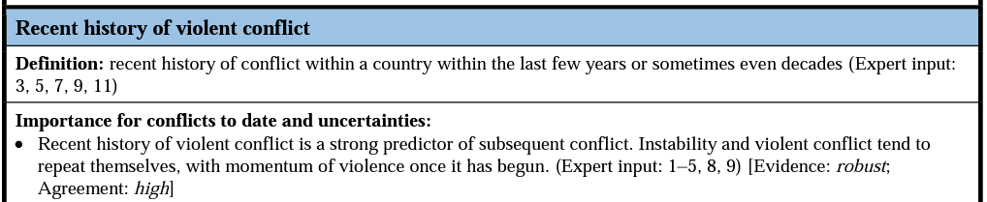
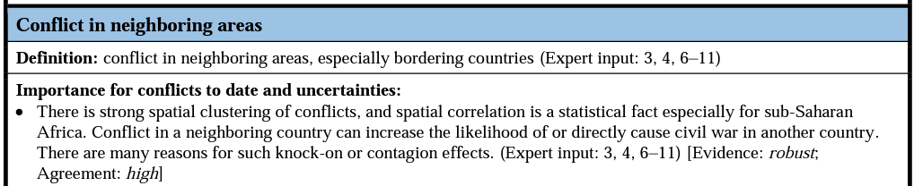
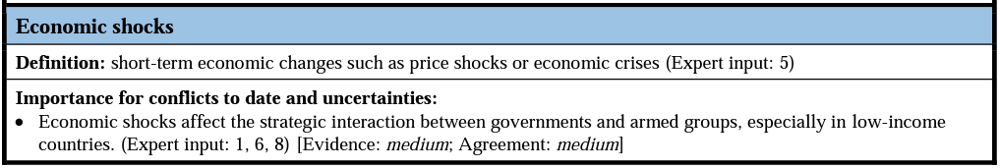
Climate as a risk factor for armed conflict pdf

Slide 18
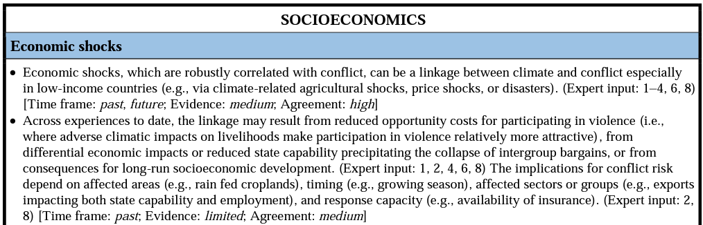
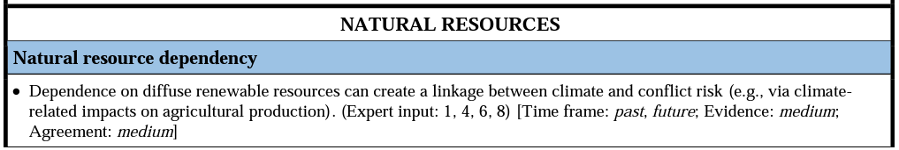
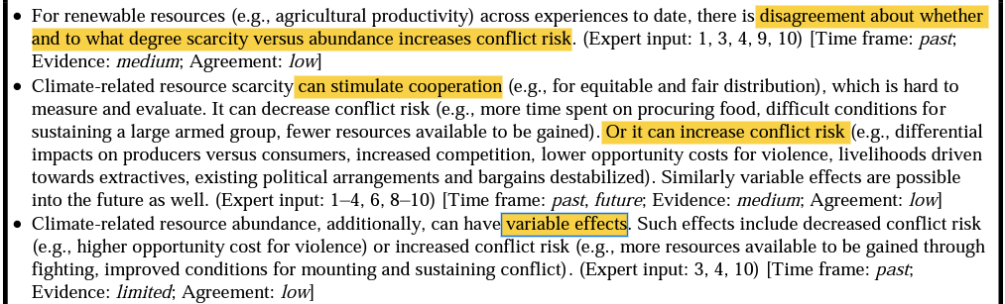

Slide 19
